Slide 1


Status of quarantine pests in South Africa and their impact on food security and agricultural trade
National Sanitary and Phytosanitary (SPS) Workshop
JH Venter
10-11 March 2021

Slide 2
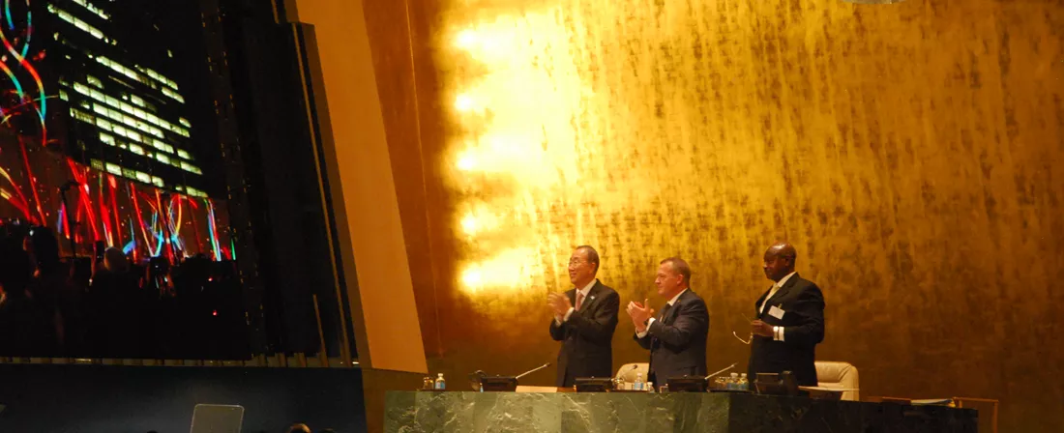
In September 2015, 193 world leaders agreed to 17 Global Goals for Sustainable Development. If these Goals are completed, it would mean an end to extreme poverty, inequality and climate change by 2030.

Slide 3
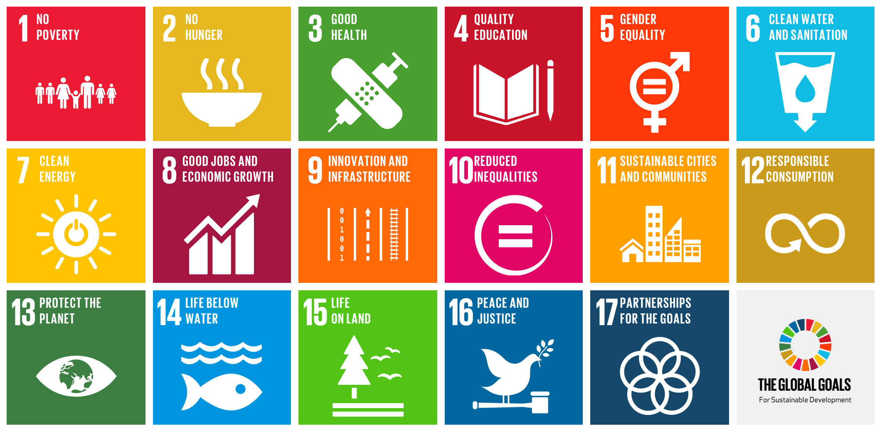

Slide 4



Slide 5
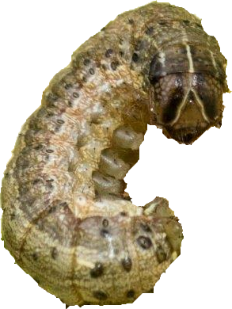
We live with pests and we will have to live with more pests
1,300 known invasive pests pathogens cost over US$540 billion per year worldwide (2016)
      The Centre for Agriculture and Biosciences International (CABI) Compendia full datasheets for 1,187 arthropod pests
      Spodoptera frugiperda (Fall Armyworm) is amongst the top 10 arthropod pests currently
https://stateoftheworldsplants.com/2017/plant-health.html
CABI has published Descriptions of Fungi and Bacteria since 1964. This includes diagnostic descriptions and background biological information on over 2100 species of fungi and bacteria, including many of the most economically important taxa.
CABI’s book “ Viruses of Plants”, covers more than 900 plant viruses.

Slide 6
Africa is open for trade
Trade and travelling increased exponentially since 1994 not only for the RSA but also for neighbours and other land-lock countries
It provide more opportunities to trade and to more countries
It also provided more opportunities for more pests to visit the region
Some decided to stay
Some pests are on their way
African Development Bank ,2010

Slide 7
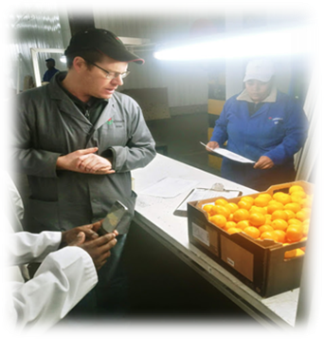
What are we protecting?
The value of primary agricultural production in South Africa was estimated at R286,4 billion in 2018, while its contribution to the GDP was estimated at R95,1 billion at prices in 2017 (DALRRD, 2020)
Our food and food for the region (Food security)
Our ability to trade with food (reduce poverty and economic growth.
Value of five export products 2019:
Citrus fruit (R19 627 million), grapes (R9 154 million), wine (R8 741 million), apples, pears and quinces (R7 711 million) and nuts (R5 945 million) (DALRRD, 2020).

Slide 8
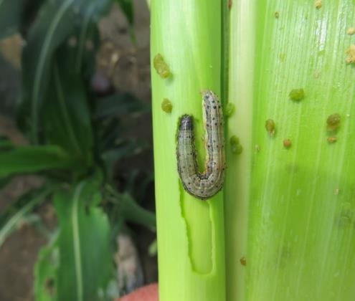
PESTS
The International Plant Protection Convention (IPPC) defines pests as:
Any species, strain or biotype of plant, animal or pathogenic agent injurious to plants or plant products
In short: plant feeding insect mite or nematode, disease causing organism or, weed
Photo: Desiree Heerden

Slide 9
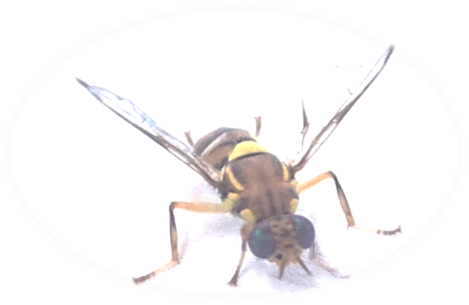
QUARANTINE PEST
A pest of potential economic importance to the area endangered thereby and not yet present there, or present but not widely distributed and being officially controlled
Thus a pest (something which will harm plants and cause economic loss) which is not yet in a country or not yet established in some areas within a country or region and which is regulated through legislation
Photo: JH Venter

Slide 10
Some recent new pests in South Africa:
Prostephanus truncates-Larger grain Borer (1999)
Bactrocera dorsalis- Oriental Fruit Fly (2010)
Acalitus vaccinii –Blueberry Bud Mite (2014)
Raoiella indica- Red Palm Mite (2016)
Banana Bunchy Top Virus (2015)
Tuta absoluta-Tuta (2016)
Spodoptera frugiperda-Fall Armyworm (2017)
Euwallacea fornicates Polyphagous Shothole Borer and its pathogenic vector Fusarium euwallaceae (2017)
Eriococcus ironsidei Macadamia felted coccid- (2017)

Slide 11
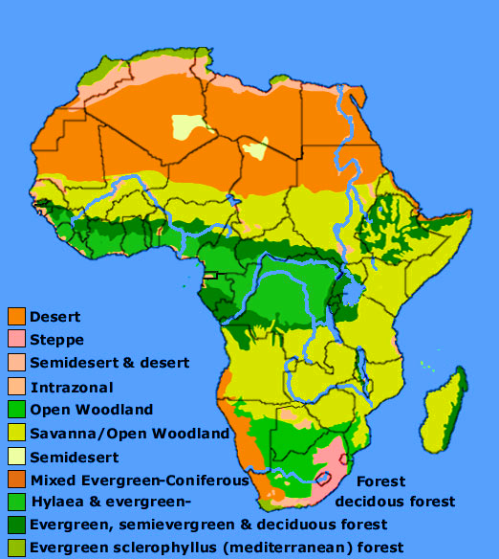
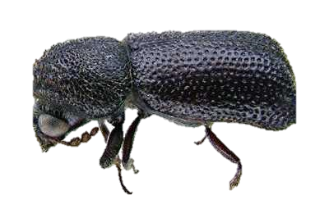
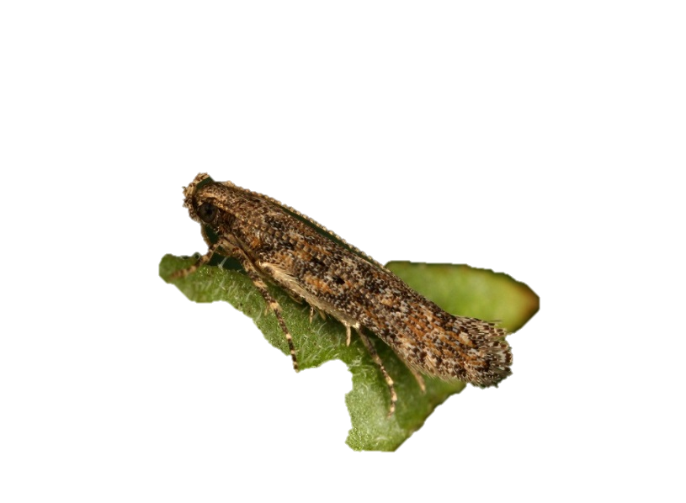
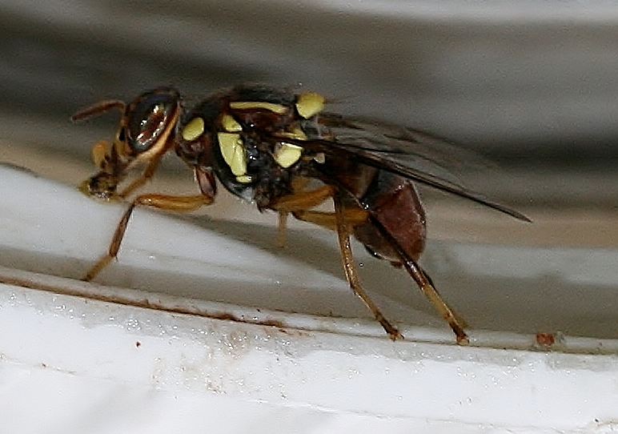
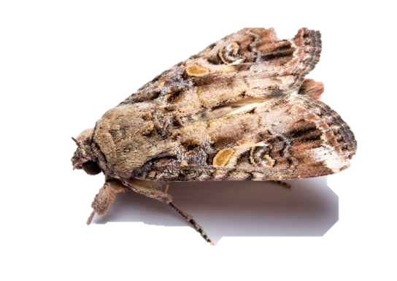
Pests which invaded most of Africa within 10 years after detection
Prostephanus truncatus: 1981-1999
Bactrocera dorsalis: 2003-2013
Tuta absoluta: 2006-2016
Spodoptera frugiperda:2016-2017
Photo: JH Venter
They all probably crossed our borders
by simply flying over
Photo:D. Visser
http://www.people.virginia.edu/~btm5g/africa_veg.jpg
Photo: Matt Bertone
http://www.infonet-biovision.org/PlantHealth/Pests/Larger-grain-borer-LGB

Slide 12

Regulatory and policy documents
Plant Health Policy
Agricultural Pests Act,1983(Act No. 36 of 1983)
National Control Measures R.110
South African Emergency Plant Pest Response Plan (SAEPPRP)
Specific plant pest contingency or action plans

Slide 13
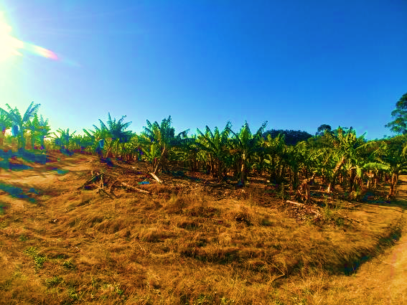
Examples of quarantine pests already in South Africa
Fall Army worm (FAW) –Detected in 9 provinces but sporadic in Western Came- Control measures R449
Oriental fruit fly- Not established in Free state, Northern, Western and Eastern Cape (Control measures R110)
Banana Bunchy Top Virus (BBTV), only established in the Ugu district KZN (Control measures R110)

Slide 14
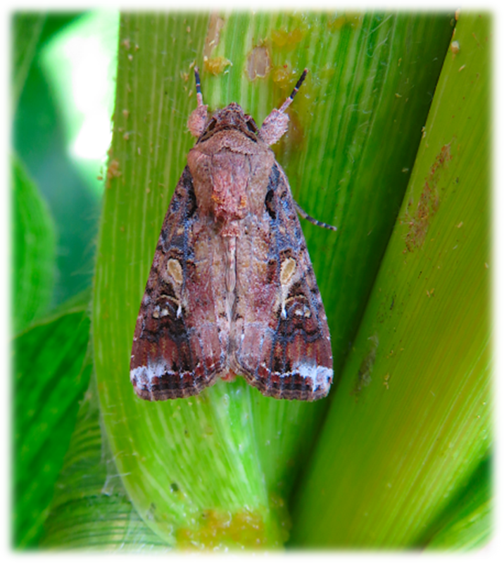
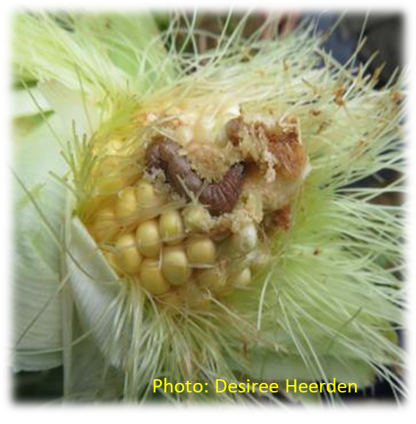
FAW
A migratory pests with a wide host range but causes mostly serious damage on maize crops in Africa
Causes serious leaf and stem damage
Also feeds on growth points, tussles and developing cobs
Male Spodoptera frugiperda adult on maize.
Photo: Desiree van Heerden
Compulsory notification and control is needed in terms of R449

Slide 15
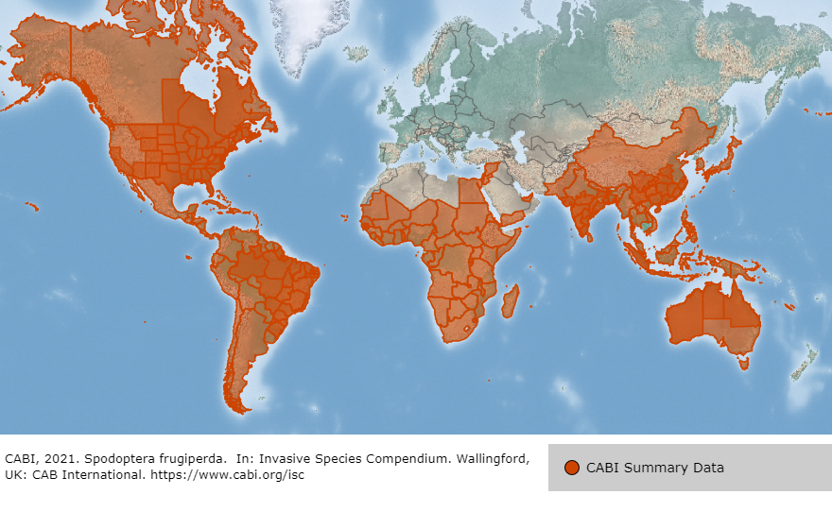

Slide 16
Oriental fruit fly
Permanent surveillance (DALRRD, Fruit Fly Africa, Producers (Exporters))
One positive (free areas)– delimiting plus quarantine
Two or more positives (free areas)- delimiting plus quarantine actions and removal control
Quarantine: 5km radius minimum by means of an official order
Delimiting: 25 square km over a 5km radius depending on topography, available host material etc.
100km radiating road transect traps
Corrective and quarantine measures: Official order
Large host range
Short life cycle
Competitive, dominating fruit fly
Large amount of eggs per fruit
Causes large amount of damage if not controlled
Restricted removal of fruit from infested(quarantine) areas are implemented in terms of R110

Slide 17
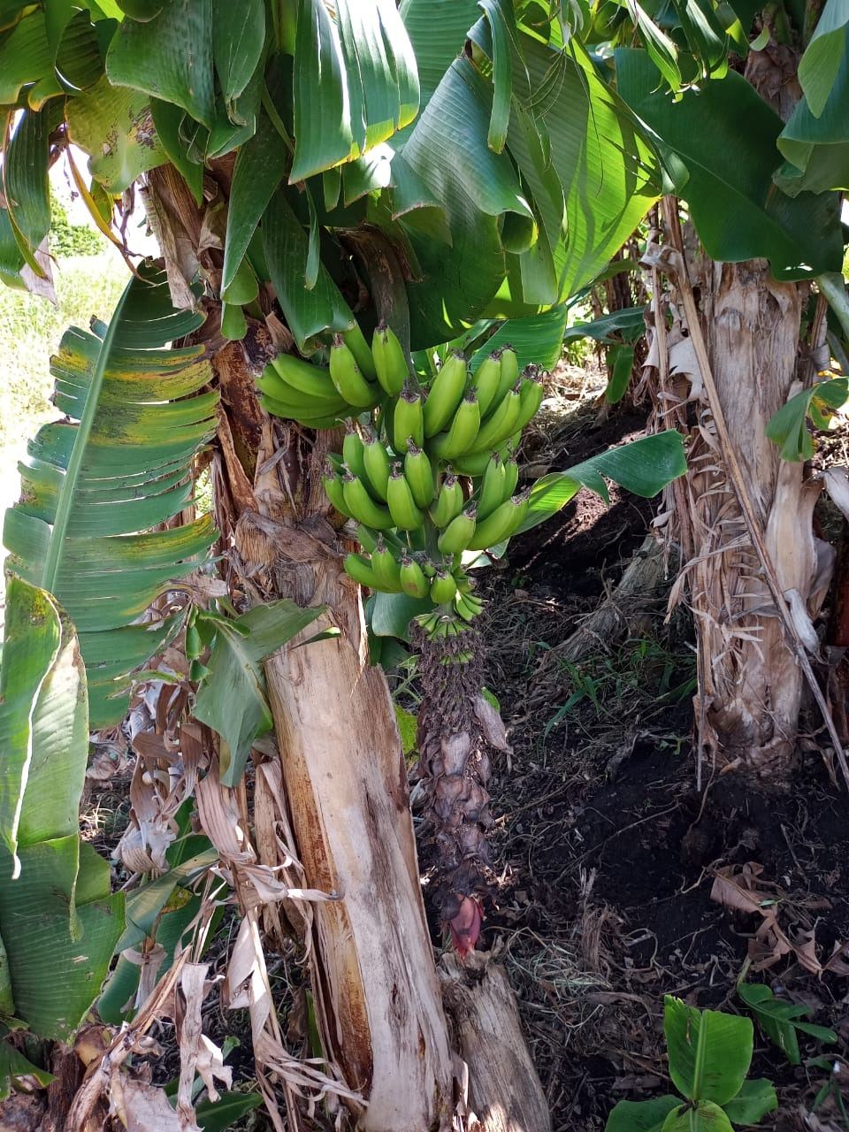
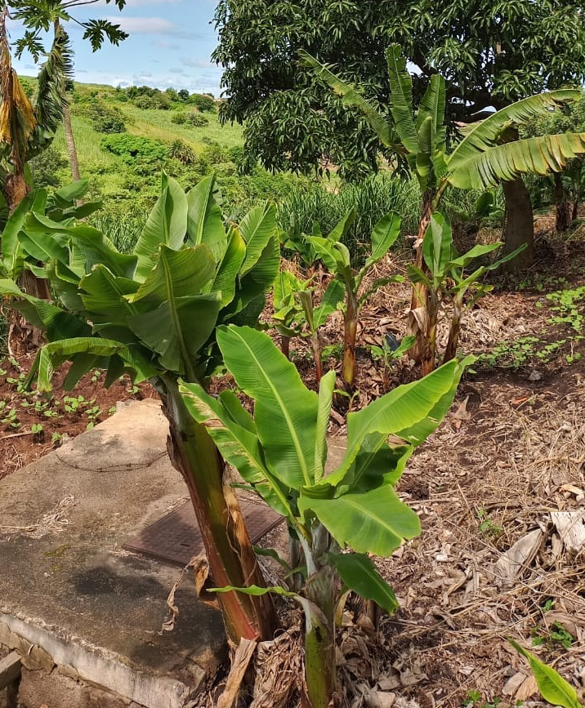

BBTV
Devastating virus on bananas
Spread by the Banana aphid and propagation material (nursery plants and suckers)
No cure and plants (normally whole mat) must be destroyed once infected while aphids are controlled chemically to avoid flying to new plants
Survey as part of the Strategic plan of DALRRD
Reduced and underdeveloped fruit
Stunted growth
The removal of propagation material is restricted in terms of R110
Photos JH Venter

Slide 18
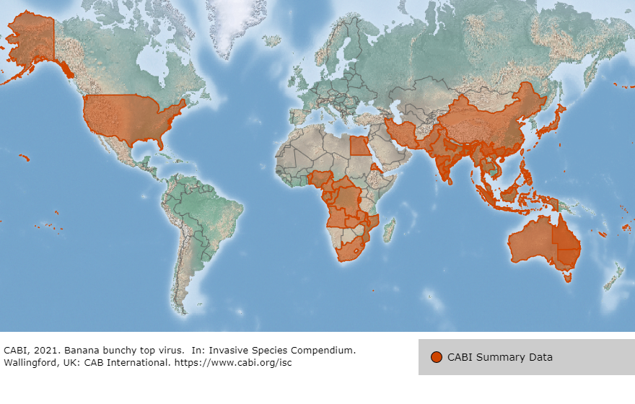

Slide 19
Serious quarantine pests in the region but not in South Africa yet
Candidatus Liberibacter aciaticus (Citrus Greening Asian strain) and its Vector Diaphorina citri Asian citrus psyllid or HLB
Fusarium oxysporum f.sp. cubense tropical race 4 or TR4
Bactrocera zonata (Peach fruit fly)
Zeugodacus cucurbitae (Melon fruit fly

Slide 20
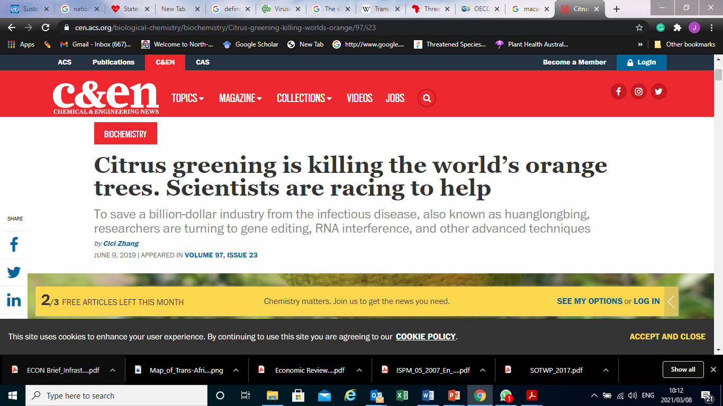
Citrus greening (HLB)
“HLB spread so widely and easily in Florida that some in the business liken it to a measles outbreak. In the past decade in the US, HLB caused an approximately 21% decrease in the fresh citrus fruit market and about a 72% decline in the production of oranges used for juice and other products (Front. Plant Sci. 2019, DOI: 10.3389/fpls.2018.01976).
And HLB isn’t a problem in just the US. In China, where the disease originated, top-producing Jiangxi Province has lost 25% of its groves as of the end of 2018. In Brazil, the disease has eliminated 52.6 million sweet orange trees, a 31% reduction in area, since 2004, when HLB was first detected there.”
Once plants are infected they must be removed as no cure exists and the plant cannot produce viable fruit

Slide 21
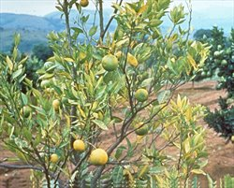
HLB
Regulated in terms of R110 and a new regulation for the pathogen and vector R121
HLB surveillance for early detection forms part of the Strategic Plan of the DALRRD
Active steering committee to ensure preparedness, surveillance and response
Pestnet.org

Slide 22
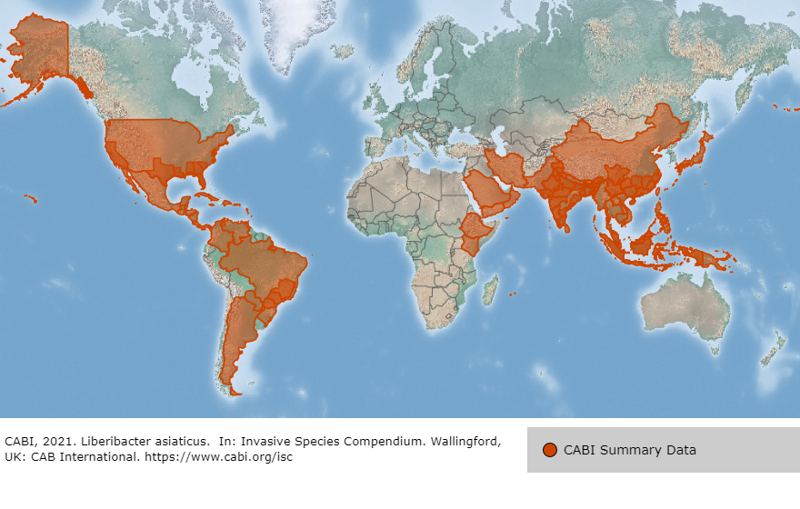

Slide 23
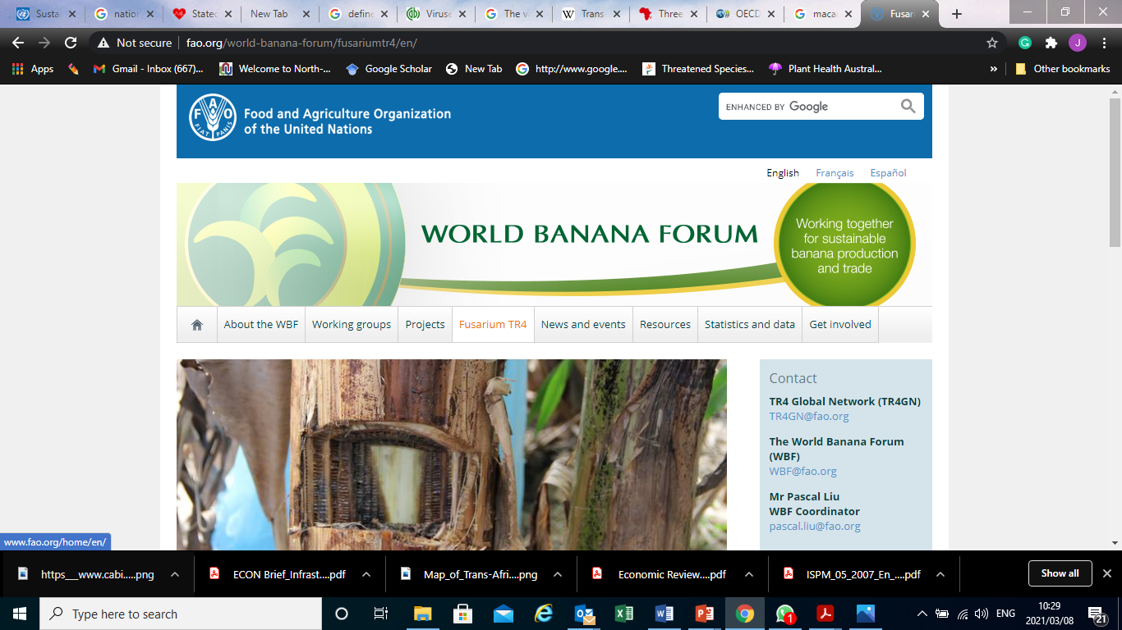
TR4
Soil borne
Spores in plant material, soil and water spread the disease
Most serious pest attacking popular Cavendish banana cultivars and there is no cure but to remove the whole plantation once infection is detected.

Slide 24
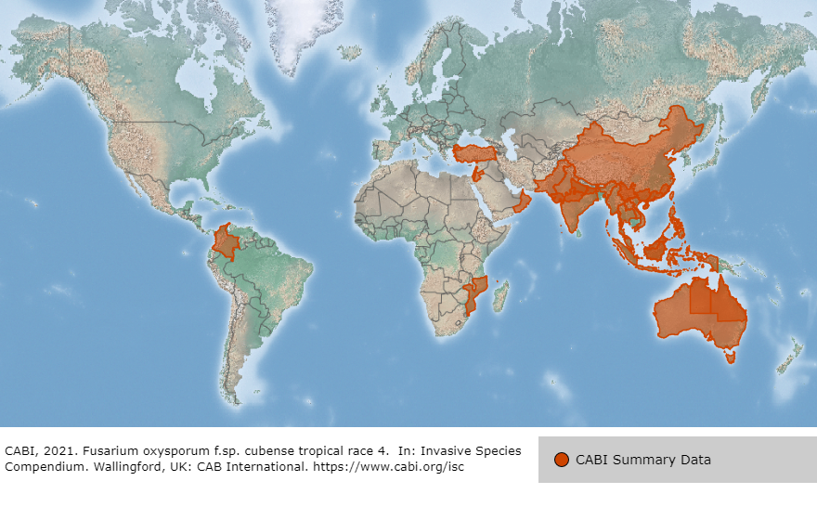

Slide 25
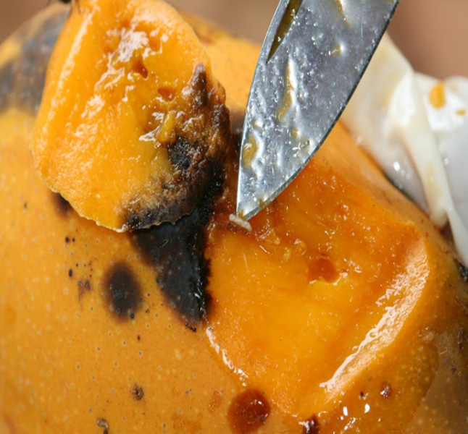
Exotic fruit flies
Large fruit host range
Cause rotten fruit, thus lower production and quality
Serious threat to market access and the maintenance of existing export markets
Must be controlled to avoid damage of 60-100% and export rejections and interceptions
Exotic fruit fly surveillance forms part of the Strategic plan of the DALRRD

Slide 26



What can be done?
Regional response
Awareness
WTO SPS STDF projects
AU-IAPSC
Inter-African Phytosanitary Council
Please talk to each other
Any suspicion please talk to DALRRD- it’s the law (R110)
Pest notification
International pest alert systems

Slide 27
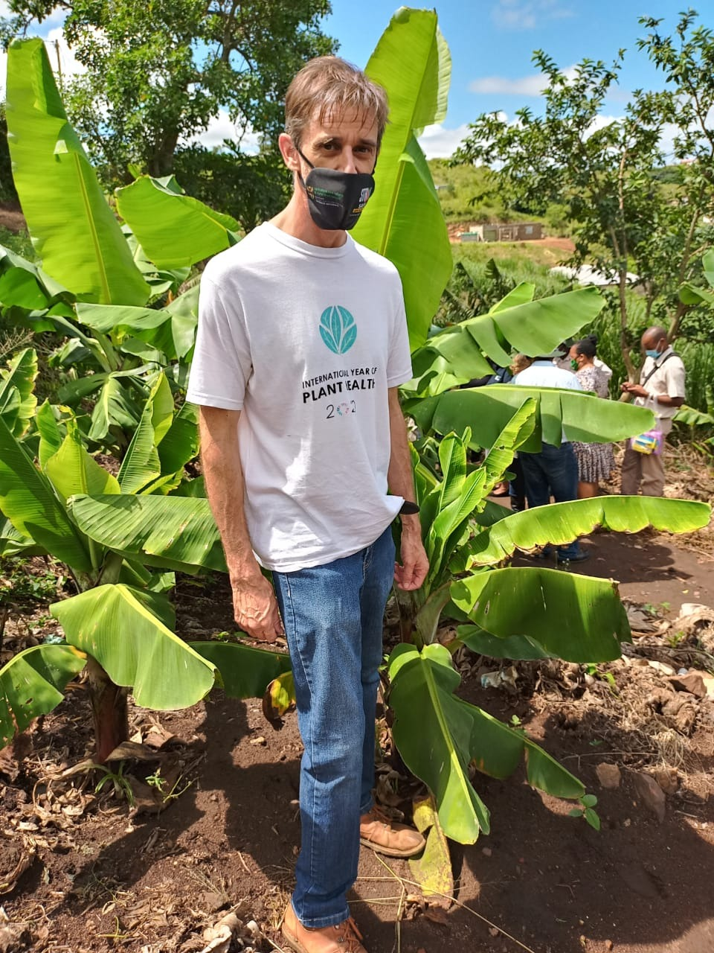
Jan Hendrik Venter
janhendrikv@dalrrd.gov.za
+27123196384
Pests don’t wait, they mate

